Slide 1
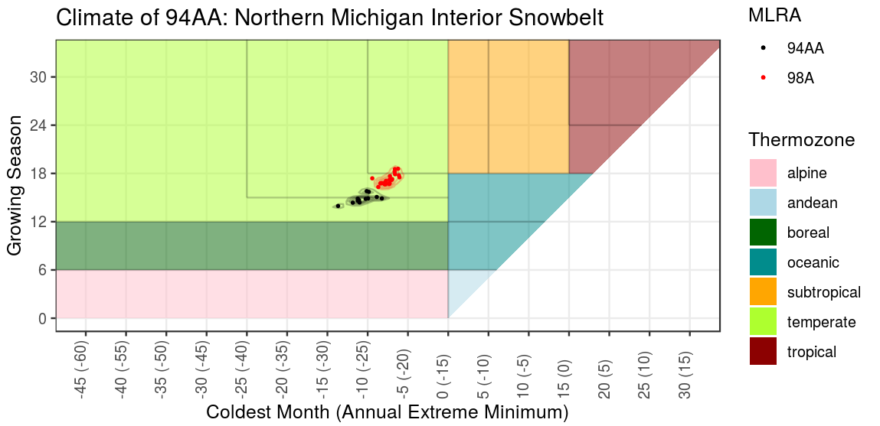
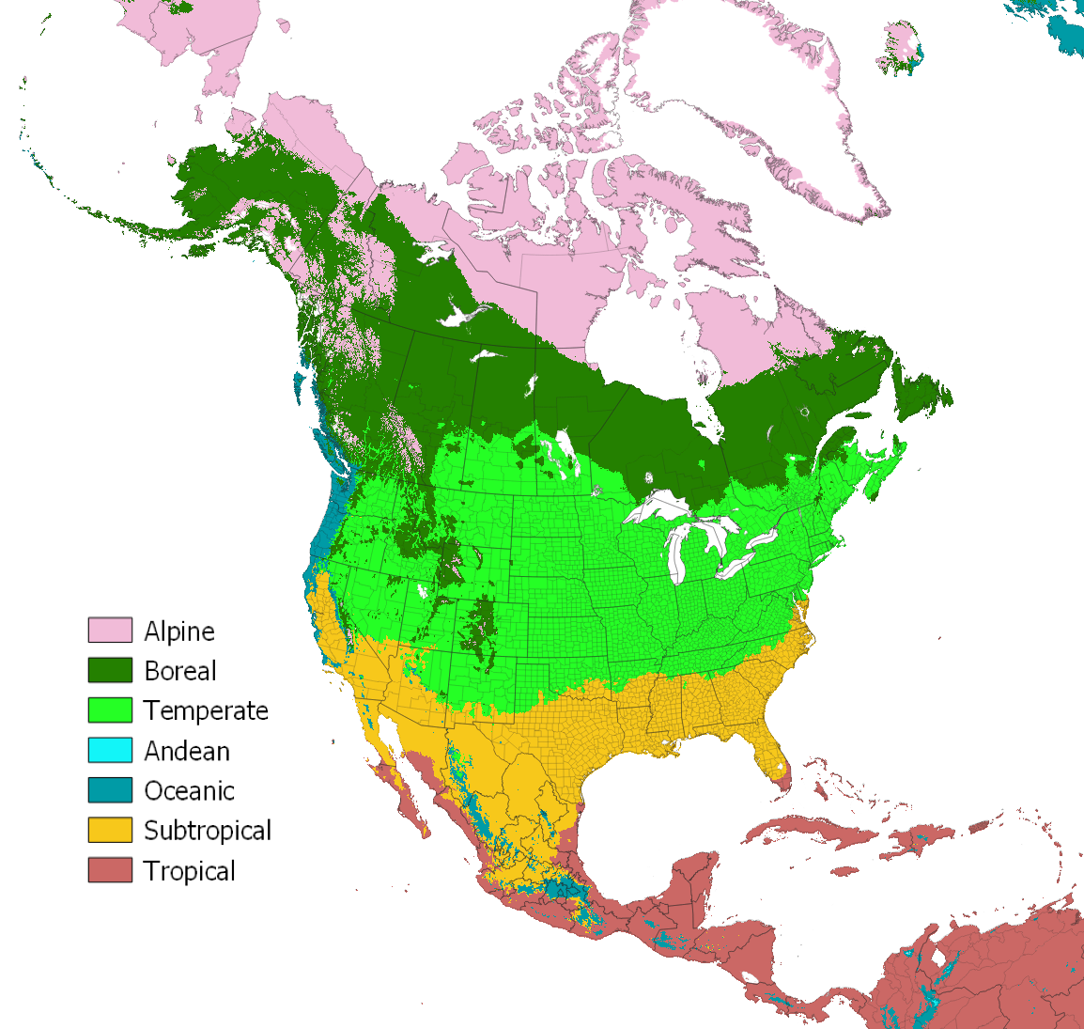
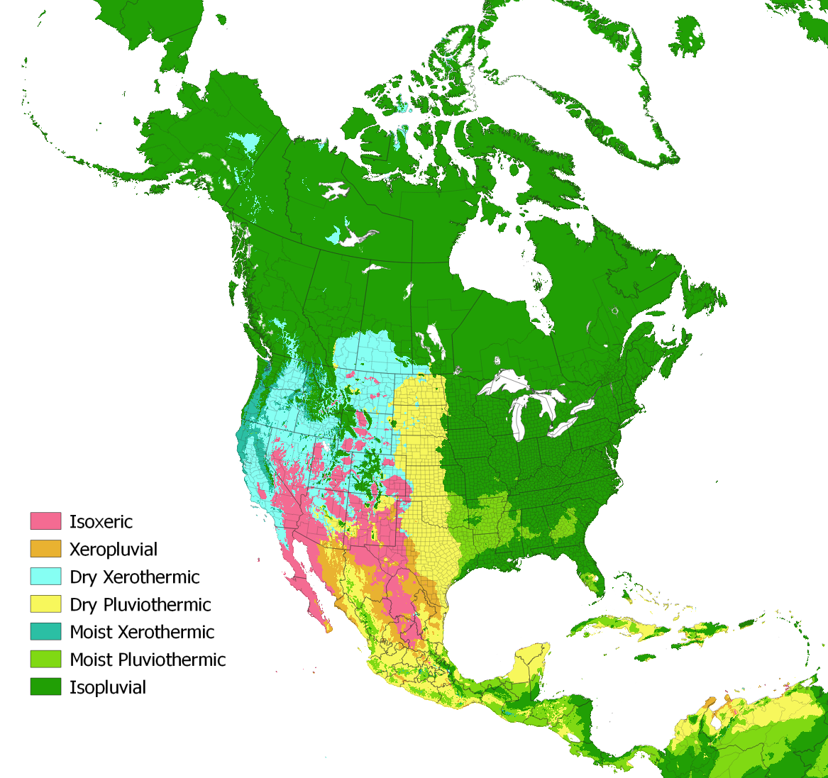
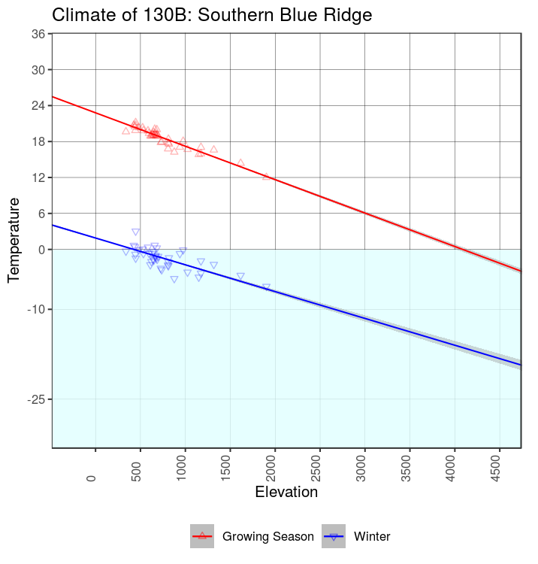
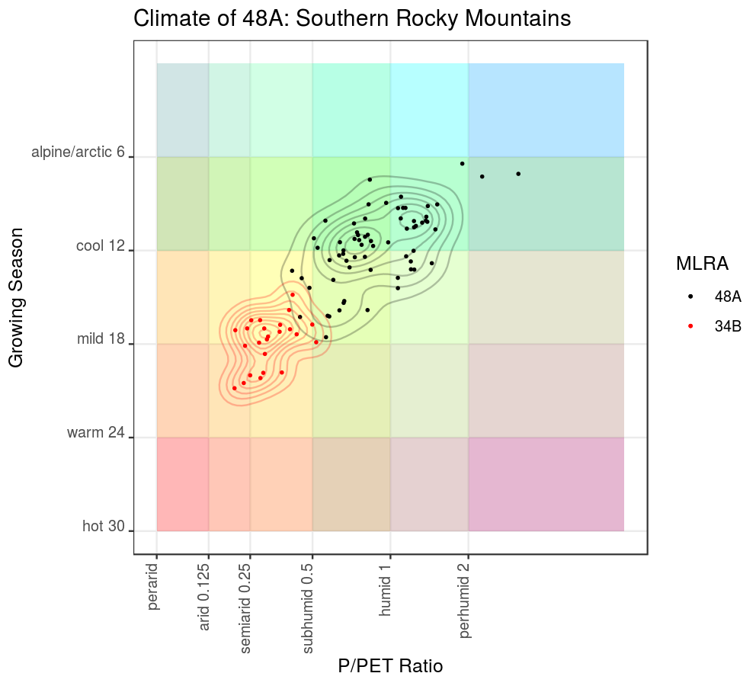
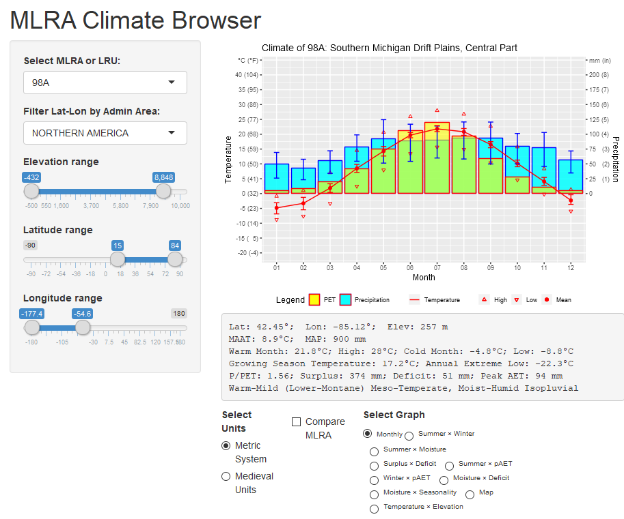
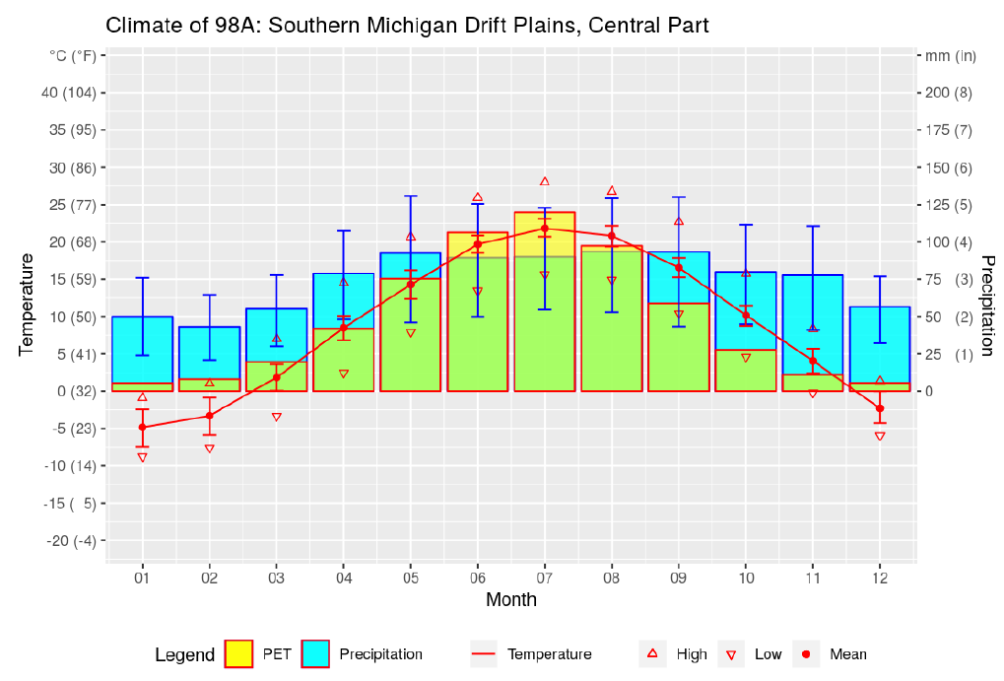
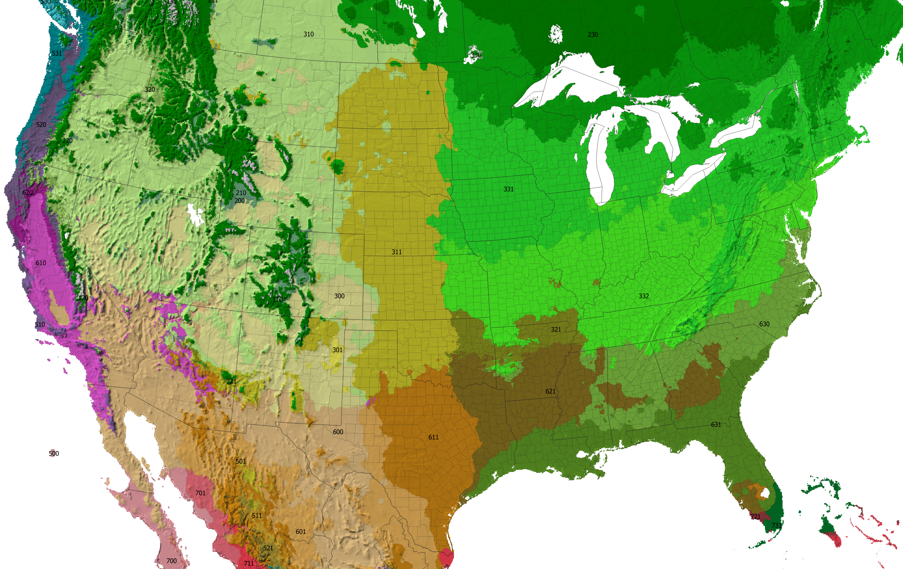

The Ecological Relevance of Parameter Choice in Describing Climate
Printing:
This poster is 48” wide by 36” high. It’s designed to be printed on a large-format printer.
NRCS Design Standards:
This template was designed to assist field staff to format technical posters that comply with USDA and NRCS visual standards.
Do not place any text, images, or logos in the USDA Isolation bar (Iso-bar). The USDA logo and signature must stand alone.
Select Your Poster Format:
To start creating your poster, choose one of the 10 slide formats from the left panel, and then delete the other remaining nine slides. Save as a PowerPoint presentation and rename the file to preserve the template for future use.
Customizing the Content:
Click on the Insert tab to add pictures, shapes, charts, text, etc.
Be sure to keep your content within the vertical and horizontal guides.
NRCS preferred fonts: Gotham, Arial, and Times New Roman
Greg Schmidt | Ecological Site Specialist | Natural Resource Conservation Service, Grand Rapids, MI | June 2019 greg.schmidt@usda.gov
Climate is an important factor in determining the broad patterns of species distribution and potential vegetation. But when similar or adjacent sites with similar soils are compared, it is not clear what if any difference in climate is responsible for differences in site potential. Ecological site descriptions commonly feature monthly and annual precipitation and temperature in climate descriptions and graphs. However, there is wide overlap among these parameters even where temperature and moisture are the primary drivers for the differences among vegetation types.
I propose several different climate parameters which have a better relationship to vegetation differences. Available moisture can only be determined when the timing of the inputs of precipitation and the outputs of potential evapotranspiration (PET) are considered with respect to growing season. Temperature can be understood both terms of optimal physiological activity, and lethal tissue limitations. The proposed parameters retain a connection to real world measurement units and are not obscure unitless indices derived from complex relationships between seemingly unrelated numbers. A Shiny application was developed to illustrate alternative graphs with which to compare different regions of the country. Maps were produced to illustrate the distribution of climate classified according to these parameters at recommended intervals.
Seven climate indices were calculated to provide a base for an alternative climate classification, and are intended to be physiologically informative for plant distribution modeling. The indices retain in real world units that can be directly related to climate change. The larger categories of the classification approximate major vegetation formations, but the indices can be subdivided into smaller, regular increments.
Comparison between two MLRAs differing in soil temperature regime (mesic vs. frigid).
https://usda.shinyapps.io/MLRAClimate/
Thermal domains
Moisture domains
Temperature and elevation curve in the Southern Appalachians projecting a timberline of 3000 m in today’s climate, well above the highest peaks.
Comparison of low elevation and high elevation MLRAs in Colorado by summer temperature and moisture.
P/PET Ratio – Mesophytic vegetation requires a constant supply of soil moisture, whereas xerophytic vegetation tolerates periods of drought. Mesophytic forests typically occur where mean annual precipitation exceeds potential evapotranspiration ratio (P/PET ratio), meaning that seasonal dry periods are more than compensated for by seasonal surpluses stored as soil moisture to maintain plant growth. Gradations in moisture regime are usually expressed on a log base 2 scale (e.g. Holdridge), from per-humid and per-arid at its wet and dry extremes respectively.
Key to Climates
1a. Tc ≥ 0°C and Tclx ≥ -15°C
2a. Tg ≥ 18°C
3a. Tc ≥ 15°C and Tclx ≥ 0°C ... Tropical
Annual P/PET ratio ≥ 1 and total monthly deficit < 150 mm
Tg ≥ 24 ... 731 Hot Tropical Isopluvial Humid -- Tropical Lowland Moist Forest
Tg < 24 ... 730 Warm Tropical Isopluvial Humid -- Tropical Premontane Moist Forest
Annual P/PET ratio < 1 or total monthly deficit ≥ 150 mm
Annual P/PET ratio ≥ 0.5 or total monthly surplus ≥ 25 mm
Annual P/PET ratio ≥ 1 ... 720-721 Tropical Pluviothermic Humid -- Tropical Seasonal/Monsoon Forest
Annual P/PET ratio < 1 ... 710-711 Tropical Pluviothermic Subhumid -- Tropical Dry Forest/Savanna
Annual P/PET ratio < 0.5 and total monthly surplus < 25 mm
peak AET ≥ 75 mm ... 701 Tropical Pluvioxeric -- Tropical Thornscrub
peak AET < 75 mm ... 700 Tropical Isoxeric -- Tropical Desert
3b. Tc < 15°C or Tclx < 0°C ... Subtropical
Annual P/PET ratio ≥ 1 and total monthly deficit < 150 mm
Tc ≥ 5° C and Tclx ≥ -10°C ... 631 Eu-Subtropical Isopluvial Humid -- Subtropical Evergreen Forest
Tc < 5° C or Tclx < -10°C ... 630 Cryo-subtropical Isopluvial Humid -- Subtropical Mixed Evergreen Forest
Annual P/PET ratio < 1 or total monthly deficit ≥ 150 mm
Annual P/PET ratio ≥ 0.5 or total monthly surplus ≥ 25 mm
Peak AET ≥ 75 mm.
Annual P/PET ratio ≥ 1 ... 621 Subtropical Pluviothermic Humid -- Subtropical Woodland/Savanna
Annual P/PET ratio < 1 ... 611 Subtropical Pluviothermic Subhumid -- Subtropical Grassland/Prairie
Peak AET < 75 mm.
Annual P/PET ratio ≥ 1 ... 620 Subtropical Xerothermic Humid -- Subtropical Sclerophyllous Forest
Annual P/PET ratio < 1 ... 610 Subtropical Xerothermic Subhumid -- Subtropical Chaparral
Annual P/PET ratio < 0.5 and total monthly surplus < 25 mm
peak AET ≥ 75 mm ... 601 Subtropical Pluvioxeric -- Subtropical Thornscrub
peak AET < 75 mm ... 600 Subtropical Isoxeric -- Subtropical Desert
2b. Tg < 18°C
4a. Tg ≥ 6°C ... Oceanic
Annual P/PET ratio ≥ 1 and total monthly deficit < 150 mm
Tg ≥ 12°C ... 531 Mild Oceanic Isopluvial Humid -- Mild Oceanic/Tropical Montane Moist Forest
Tg < 12°C ... 530 Cool Oceanic Isopluvial Humid -- Cool Oceanic/Tropical Subalpine Moist Forest
Annual P/PET ratio < 1 or total monthly deficit ≥ 150 mm
Annual P/PET ratio ≥ 0.5 or total monthly surplus ≥ 25 mm
Peak AET ≥ 75 mm.
Annual P/PET ratio ≥ 1 ... 521 Oceanic Pluviothermic Humid -- Subtropical Montane Seasonal Forest
Annual P/PET ratio < 1 ... 511 Oceanic Pluviothermic Subhumid -- Subtropical Montane Xeric Woodland
Peak AET < 75 mm.
Annual P/PET ratio ≥ 1 ... 520 Oceanic Xerothermic Humid -- Oceanic Sclerophyllous Forest
Annual P/PET ratio < 1 ... 510 Oceanic Xerothermic Subhumid -- Oceanic Chaparral
Annual P/PET ratio < 0.5 and total monthly surplus < 25 mm
peak AET ≥ 75 mm ... 501 Oceanic Pluvioxeric -- Oceanic Desert-Grassland
peak AET < 75 mm ... 500 Oceanic Isoxeric -- Oceanic Desert
4b. Tg < 6°C ... Andean
Annual P/PET ratio ≥ 1 ... 420-430 Andean Humid -- Paramos
Annual P/PET ratio < 1 ... 400-410 Andean Subhumid -- Puna
1b. Tc ≥ 0° C or Tclx < -15°C
5a. Tg ≥ 12°C ... Temperate
Annual P/PET ratio ≥ 1 and total monthly deficit < 150 mm
Tg ≥ 18°C and Tc ≥ -10° C and Tclx ≥ -25°C ... 332 Warm Thermo-temperate Isopluvial Humid -- Warm Temperate Deciduous Forest
Tg < 18°C or Tc ≥ -10° C or Tclx ≥ -25°C
Tg ≥ 15°C and Tc ≥ -25° C or Tclx ≥ -40°C ... 331 Mild Meso-temperate Isopluvial Humid -- Mild Temperate Deciduous/Mixed Forest
Tg < 15°C or Tc < -25° C or Tclx < -40°C ... 330 Mild Cryo-temperate Isopluvial Humid -- Hemiboreal Mixed Forest
Annual P/PET ratio < 1 or total monthly deficit ≥ 150 mm
Annual P/PET ratio ≥ 0.5 or total monthly surplus ≥ 25 mm
Peak AET ≥ 75 mm.
Annual P/PET ratio ≥ 1 ... 321 Temperate Pluviothermic Humid -- Temperate Woodland/Savanna
Annual P/PET ratio < 1 ... 311 Temperate Pluviothermic Subhumid -- Temperate Grassland/Prairie
Peak AET < 75 mm.
Annual P/PET ratio ≥ 1 ... 320 Temperate Xerothermic Humid -- Temperate Dry Evergreen Forest
Annual P/PET ratio < 1 ... 310 Temperate Xerothermic Subhumid -- Temperate Steppe/Shrub-Steppe
Annual P/PET ratio < 0.5 and total monthly surplus < 25 mm
peak AET ≥ 75 mm ... 301 Temperate Pluvioxeric -- Temperate Desert-Grassland
peak AET < 75 mm ... 300 Temperate Isoxeric -- Temperate Desert
5b. Tg < 12°C
6a. Tg ≥ 6°C ... Boreal
Annual P/PET ratio ≥ 1 ... 220-230 Boreal Humid -- Boreal Forest
Annual P/PET ratio < 1 ... 200-211 Boreal Subhumid -- Cool Shrubland
6b. Tg < 6°C ... Arctic
Annual P/PET ratio ≥ 1 ... 120-130 Arctic Humid -- Moist Tundra
Annual P/PET ratio < 1 ... 100-111 Arctic Subhumid -- Dry Tundra
Surplus & Deficit – Even in a humid climate, significant seasonal drought occurs where the cumulative loss of moisture evapotranspiration exceeds that of available soil water holding capacity within the rooting zone. A deficit of 150 mm or more is considered significant for most soils and would require adaptations of thickened leaves or deciduousness to protect a plant from drying out. Most tropical forests become deciduous as deficits exceed 300 mm, even if annual precipitation to PET ratios remain positive. Desert vegetation may occur where precipitation is less than half required to maintain soil moisture, and that significant seasonal surpluses do not support seasonal growth of mesophytic vegetation. Instead, desert vegetation must avail themselves with episodic rainfall that never wets the whole soil profile.
Growing Season Temperature is the positive average temperature of the warmest 6 months (any sub-freezing months are counted as zeros). Körner (1998) demonstrated that the cold limits of forest growth across a wide range of latitudes share a growing season temperature of 6 to 7°C.
Previous attempts at pinning timberline to a highest monthly mean temperature of 10°C (e.g. the Köppen-Geiger system, Kottek et al, 2006), and Holdridge’s (1947) mean annual biotemperature of 3°C are most successful if applied only to middle and high latitudes. But in tropical mountains, where the annual range in monthly temperature is small, the highest forests grow where maximum monthly mean temperatures and mean annual temperatures converge toward 6°C. This temperature threshold can be realized at higher latitude timberlines simply by calculating the positive temperature for the warmest six months, instead of for the whole year.
Climatic subdivisions – seasonal temperature and precipitation regimes.
Peak AET – For climates with seasonal variability in moisture, plants must employ a strategy of either tolerance or avoidance to survive the dry season. The timing of the dry season, however is of less importance compared the timing of the wet season. If the wet season coincides with temperatures favoring maximum growth, the strategy is avoidance, allowing annual regrowth of more efficient deciduous organs optimized for higher peak productivity. In contrast, if moisture is only available during periods of lower temperatures, the strategy is tolerance, allowing persistence through long periods of low productivity. In addition, when warm temperatures coincides with precipitation, the frequency of lightning is higher and fire return interval is shorter, further giving advantage to grassland vegetation over shrubland.
Actual monthly evapotranspiration (AET) is an indicator of how much precipitation of the current month is used in that month. A minimally tropical month at 15°C would generally result in a PET of at least 75 mm. Therefore, a tropical rainy should have a peak monthly AET of greater than or equal to 75 mm. Plants in seasonally moist climates with peak AET less than 75 mm either lack a warm season, or are moist only during the cool season. Cool grasslands can prevail with peak AET less than 75 mm, though scrub-steppe vegetation usually occurs once peak AET falls below 50 mm.
It should be acknowledged that landscape roughness (slope) is a non-climate variable that interacts with climate in predicting fire frequency. Large contiguous flat expanses historically burned more frequently than areas interrupted with hills, and are thereby biased towards support of grassland vegetation.
Applications – Annual temperature and precipitation gives a very limited idea of how vegetation might be affected by trends, whether it be across the landscape or through time. This climate classification and related indices represent a hypothesis on the primary climatic drivers of vegetation, at least with respect to the parameters available as global data sets. Observed geographic gradients in one or more index independent of soils can in turn generate hypotheses on causal factors behind a particular vegetation type, and lead to predictions on how vegetation might behave in the future. In as much as future vegetation does not follow predicted trends, other causal phenomena can be discovered and mitigated if necessary. As vegetation patterns are studied, the primary increments in the classification could be adjusted to better match the vegetation. However, precision is not the intent in the classification, as it is more useful to discuss a range in potential vegetation types between fixed climatic benchmarks, than it is to presume a one to one relationship.
Annual Extreme Low & Coldest Mean Monthly Temperature – Cold temperature effects vegetation in two ways; it can simply be too cold for metabolic activity, or it can damage tissues. The capability of evergreens to remain functional at a lower temperature must be balanced with the risk of damage by even colder temperatures or the loss in efficiency at warmer temperatures. Mean monthly temperature below freezing offers little advantage to an evergreen and risks desiccation due to frozen soils. Therefore, most evergreens in the temperate zone have thickened needle and scale leaves with small surface areas to avoid damage.
Where the coldest monthly means remain above freezing, broadleaf evergreen vegetation can be supported. However, most broadleaf evergreens, such as those found in subtropical climates, are damaged when temperatures drop below -15°C Prentice et al, (1992) and Box (1996). Tropical vegetation is nearly intolerant of any subfreezing temperature, and in some cases, can be damaged by cold a few degrees above freezing.
The synthesis of extreme cold and average cold into a single index, offset by 15 degrees, was made to emphasize the effects of winter extremes in the continental northern hemisphere, while focusing on metabolic limitations where extreme temperatures are lacking in oceanic southern hemisphere.
References
Climate maps derived from these raster GIS data sources:
Daly, C., Halbleib, M., Smith, J.I., Gibson, W.P., Doggett, M.K., Taylor, G.H., Curtis, J., and Pasteris, P.A. 2008. Physiographically-sensitive mapping of temperature and precipitation across the conterminous United States. International Journal of Climatology, 28: 2031-2064. (http://prism.oregonstate.edu/normals/)
Daly, C., Widrlechner, M.P., Halbleib, M.D., Smith, J.I. and Gibson, W.P., 2012. Development of a new USDA plant hardiness zone map for the United States. Journal of Applied Meteorology and Climatology, 51(2), pp.242-264.
Hijmans, R.J., S.E. Cameron, J.L. Parra, P.G. Jones and A. Jarvis, 2005. Very high resolution interpolated climate surfaces for global land areas. International Journal of Climatology 25: 1965-1978. (http://www.worldclim.org/version1)
Magarey, R.D., Borchert, D.M. and Schlegel, J.W., 2008. Global plant hardiness zones for phytosanitary risk analysis. Scientia Agricola, 65(SPE), pp.54-59.
Alternative Climate Classifications:
Holdridge, L.R., 1947. Determination of world plant formations from simple climatic data. Science, 105(2727), pp.367-368.
Lugo, A.E., Brown, S.L., Dodson, R., Smith, T.S. and Shugart, H.H., 1999. The Holdridge life zones of the conterminous United States in relation to ecosystem mapping. Journal of biogeography, 26(5), pp.1025-1038.
Kottek, M., Grieser, J., Beck, C., Rudolf, B. and Rubel, F., 2006. World map of the Köppen-Geiger climate classification updated. Meteorologische Zeitschrift, 15(3), pp.259-263.
Rivas-Martínez, S., 2004. Global bioclimatics. Classificación Bioclimática de la Tierra. http://www.globalbioclimatics.org/form/maps.htm
Thornthwaite, C.W., 1948. An approach toward a rational classification of climate. Geographical review, 38(1), pp.55-94.
####Alternative PET calculations:
Lu, J., Sun, G., McNulty, S.G. and Amatya, D.M., 2005. A comparison of six potential evapotranspiration methods for regional use in the southeastern United States 1. JAWRA Journal of the American Water Resources Association, 41(3), pp.621-633.
Other publications relating climate to vegetation:
Faber-Langendoen, D.; Keeler-Wolf, T.; Meidinger, D.; Josse, C.; Weakley, A.; Tart, D.; Navarro, G.; Hoagland, B.; Ponomarenko, S.; Saucier, JP; Fults, G.; Helmer, E. 2012. Classification and description of world formation types. Part II (Description of formation types). Hierarchy Revisions Working Group, Federal Geographic Data Committee, FGDC Secretariat, US Geological Survey and NatureServe, Reston, VA and Arlington, VA. http://usnvc.org/explore-classification/
Bailey, R.G., 1998. Ecoregions of North America (No. 1548). US Department of Agriculture, Forest Service.Box, E.O., 1996. Plant functional types and climate at the global scale. Journal of Vegetation Science, 7(3), pp.309-320.
Körner, C., 1998. A re-assessment of high elevation treeline positions and their explanation. Oecologia, 115(4), pp.445-459.
Olson, D.M., Dinerstein, E., Wikramanayake, E.D., Burgess, N.D., Powell, G.V., Underwood, E.C., D'amico, J.A., Itoua, I., Strand, H.E., Morrison, J.C. and Loucks, C.J., 2001. Terrestrial Ecoregions of the World: A New Map of Life on Earth: A new global map of terrestrial ecoregions provides an innovative tool for conserving biodiversity. BioScience, 51(11), pp.933-938.
Prentice, I.C., Cramer, W., Harrison, S.P., Leemans, R., Monserud, R.A. and Solomon, A.M., 1992. Special paper: a global biome model based on plant physiology and dominance, soil properties and climate. Journal of biogeography, pp.117-134.
Sakai, A., 1981. Freezing resistance of broad-leaved evergreen trees in the warm-temperate zone. Low temperature Science. Ser. B, Biological sciences, 38, pp.1-14.
Sakai, A. and Weiser, C.J., 1973. Freezing resistance of trees in North America with reference to tree regions. Ecology, 54(1), pp.118-126.
Schenk, H.J. and Jackson, R.B., 2002. The global biogeography of roots. Ecological monographs, 72(3), pp.311-328.
Wright, I.J., Dong, N., Maire, V., Prentice, I.C., Westoby, M., Díaz, S., Gallagher, R.V., Jacobs, B.F., Kooyman, R., Law, E.A. and Leishman, M.R., 2017. Global climatic drivers of leaf size. Science, 357(6354), pp.917-921.
Tg = mean positive (subzero temperatures counted as zero) temperature of the warmest 6 months.
Tc = mean temperature of the coldest month.
Tclx = mean annual extreme low temperature.
P/PET = annual precipitation to potential evapotranspiration ratio.
Deficit = cumulative deficit in monthly precipitation.
Surplus = cumulative surplus in monthly precipitation.
Peak AET = highest monthly actual evapotranspiration with no soil moisture storage.
Natural Resources Conservation Service l Soil and Plant Science Division l nrcs.usda.gov/soils

